Slide 1

MICROSPECTRA SOFTWARE TECHNOLOGIES PVT. LTD.
INTRODUCTION TO
DATA SCIENCE ARTIFICIAL INTELLIGENCE
MACHINE LEARNING DEEP LEARNING
Topic:- Machine Learning(lect no:-6)
Certification & Internship Program

Slide 2
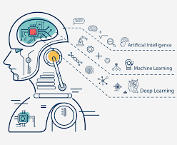
INTRODUCTION TO MACHINE LEARNING
What Is Machine Learning ?
“Learning is any process by which a system improves performance from experience.”
- Herbert Simon
Definition by Tom Mitchell (1998):
Machine Learning is the study of algorithms that
• improve their performance P
• at some task T
• with experience E.
A well-defined learning task is given by <P, T, E>
MICROSPECTRA SOFTWARE TECHNOLOGIES PVT.LTD

Slide 3
INTRODUCTION TO MACHINE LEARNING
TRADITIONAL PROGRAMMING V/S MACHINE LEARNING
Traditional Progarmming
Machine Learning
COMPUTER
COMPUTER
COMPUTER
DATA
DATA
PROGRAM
DATA
OUTPUT
OUTPUT
OUTPUT
(MODEL)
PROGRAM
(MODEL)
Output Data is Deterministic
Output Data is Deterministic
www.microspectra.in

Slide 4
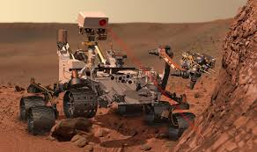


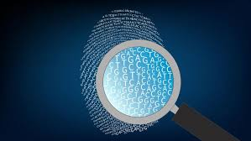
INTRODUCTION TO MACHINE LEARNING
WHEN DO WE USE MACHINE LEARNING?
1)Human experties
Does not exist
(navigation on Mars)
3)Module Must be Customized
(Personilized Medicine)
2)Human cant explain their expertise
(Speech Recognition)
4)Model are based on huge amount of Data
(genomics)
International Certifications & Internship Programs

Slide 5
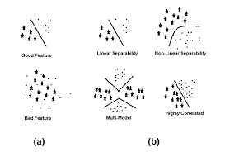
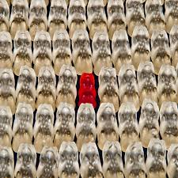
INTRODUCTION TO MACHINE LEARNING
SOME MORE EXAMPLES OF TASK ARE BEST SOLVED BY USING A LEARNING ALGORITHM
1) Recognizing patterns
Facial Identities or Facial Expressions.
Handwritten or spoken words.
Medical Images
2) Generating Patterns
Generating Images Or Motio Sequences
3) Recognizing Anomalies
Unusual credit card transactions.
Unusual patterns of sensors reading in
nuclear power plant.
4)Prediction.
Future Stock Price or Currency exchange rates.
Microsoft Technology Associate Certification In Python

Slide 6
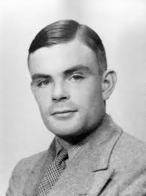
INTRO TO ARTIFICIAL INTELLIGENCE
Simulating Intelligence – The Turing Test
Alan Turing, the inventor of the Turing machine, an abstract concept that's used
in algorithm theory, suggested a way to test intelligence. This test is referred to
as the Turing test in AI literature
Using a text interface, an interrogator chats to a human and a chatbot. The job of the chatbot is to mislead the interrogator to the extent that they cannot tell whether the computer is human or not.
What disciplines do we need to pass the Turing test?
First of all, we need to understand a spoken language to know what the interrogator is saying. We do this by using Natural Language Processing (NLP). We also have to respond.
We need to be an expert on things that the human mind tends to be interested in. We need to build an Expert System of humanity, involving the taxonomy of objects and abstract thoughts in our world, as well as historical events and even Emotions.
Microsoft Technology Technology Associate In Web Development

Slide 7
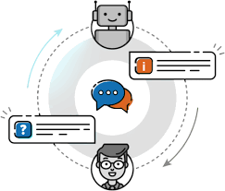
INTRO TO ARTIFICIAL INTELLIGENCE
AI Tools and Learning Models
Intelligent Agents
When solving AI problems, we create an actor in the environment that can
gather data from its surroundings and influence its surroundings. This actor is called an intelligent agent.
An intelligent agent:
Is autonomous
Observes its surroundings through sensors
Acts in its environment using actuators
Directs its activities toward achieving goals
Internship Progarm in AI, ML, DL, Data Science

Slide 8
INTRO TO ARTIFICIAL INTELLIGENCE
Classification and Prediction
Different goals require different processes. Let's explore the two most popular types of AI reasoning: classification and prediction.
Classification
a process for figuring out how an object can be defined in terms of another object. For instance, a father is a male who has one or more children.
If Jane is a parent of a child and Jane is female, then Jane is a mother. Also, Jane
is a human, a mammal, and a living organism. We know that Jane has a
nationality as well as a date of birth.
Prediction
the process of predicting things, based on patterns and probabilities. For instance, if a customer in a standard supermarket buys organic
milk, the same customer is more likely to buy organic yoghurt than the average
Customer.
Microsoft Technology Technology Associate In Web Development

Slide 9
INTRO TO ARTIFICIAL INTELLIGENCE
Learning Models
The process of AI learning can be done in a supervised or unsupervised way.
Supervised learning is based on labeled data and inferring functions from
training data.
Linear regression is one example.
Unsupervised learning is based on unlabeled data and often works on cluster analysis.
Internship Progarm in Web Development

Slide 10
